Slide 1
P A S S W O R D
A U T H E N T I C A T E D
K E Y
E X C H A N G E
B Y
J U G G L I N G

Slide 2
Introduction

Slide 3
Introduction
Communication between a pair of users over a public unreliable channel with a secure session key.
e.g. SIGMA protocol used as the basis for the signature-based modes of the Internet Key Exchange (IKE) protocol
Password-Authenticated Key Exchange (PAKE) studies how to establish secure communication between two remote parties solely based on their shared password, without requiring a Public Key Infrastructure (PKI).
Passwords are low-entropy secrets, and subject to dictionary attacks.
To protected during transmission password is sent by the widely deployed method known as SSL/TLS.
Drawback of using SSL/TLS is that it is subject to man-in-the-middle attacks.
Cryptographically secure private keys was adopted by the UK National Grid Service (NGS) to authenticate users.
Researchers have been actively exploring ways to perform password-based authentication without using PKIs or certificates – a research subject called the Password-Authenticated Key Exchange (PAKE).

Slide 4
Password authenticated key exchange (PAKE)
Two forms of PAKE are Balanced and Augmented methods.
Balanced PAKE allows parties that use the same password to negotiate and authenticate a shared key.
Examples of Balanced PAKE are:
Encrypted Key Exchange(EKE)
PAK and PPK
SPEKE (Simple password exponential key exchange)
J-PAKE (Password Authenticated Key Exchange by Juggling)
Augmented PAKE is a variation applicable to client/server scenarios, in which an attacker must perform a successful brute-force attack in order to masquerade as the client using stolen server data.
Examples of Augmented PAKE :
AMP
Augmented-EKE
B-SPEKE
PAK-Z
SRP

Slide 5
DIFFIE- HELLMAN KEY
EXCHANGE

Slide 6
DIFFIE- HELLMAN KEY EXCHANGE
The first published public-key algorithm appeared in the seminal paper by Diffie and Hellman that defined public-key cryptography and is generally referred to as Diffie-Hellman Key Exchange.
The purpose of this algorithm is to enable two users to securely exchange a key that can be used for subsequent encryption of messages.
The Diffie-Hellman algorithm depends for its effectiveness on the difficulty of computing discrete logarithms.
First we define a primitive root of a prime number p as one whose power modulo p generates all integers from 1 to p-1.

Slide 7
DIFFIE- HELLMAN KEY EXCHANGE(cntd.)
If a is a primitive root of a prime number p then the numbers
a mod p, a² mod p,……, a^{p-1} mod p
are distinct and consists of integers 1 through p-1 in some permutation.
For any integer b and a prime root a of prime number p, we can find a unique exponent i such that
b = a^{i} mod p where 0 ≤ i ≤ (p-1)
The exponent i is referred to as the discrete logarithm of b for the base a, mod p.
Diffie–Hellman establishes a shared secret that can be used for secret communications by exchanging data over a public network.

Slide 8
DIFFIE- HELLMAN KEY EXCHANGE(cntd.) Description
Alice and Bob agree on a finite cyclic group G and a generating element g in G (This is usually done long before the rest of the protocol; g is assumed to be known by all the attackers). We will write the group G multiplicatively.
Alice picks a random natural number a and sends gª to Bob.
Bob picks a random natural number b and sends g^{b} to Alice.
Alice computes (g^{b})ª.
Bob computes (gª)^{b}.
Both Alice and Bob are now in possession of the group element g^{ab}, which can serve as the shared secret key. The values of (g^{b})ª and (gª)^{b} are the same because groups are power associative.

Slide 9
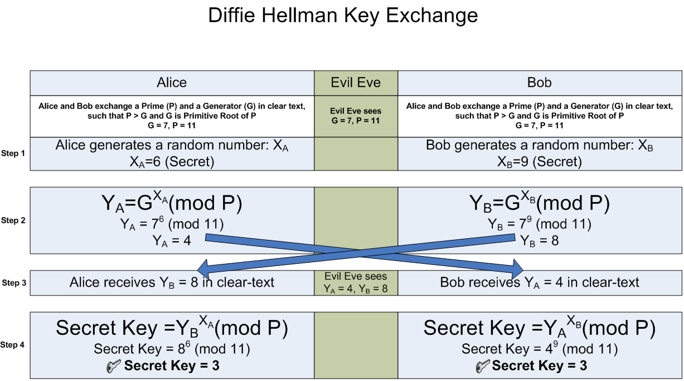
DIFFIE- HELLMAN KEY EXCHANGE(cntd.) Description

Slide 10
DIFFIE- HELLMAN KEY EXCHANGE(cntd.) Algorithm
Two publicly known numbers:
a prime number p
an integer g that is a primitive root of p
User A selects a random integer X_{A} < p and computes Y_{A} = g ^{XA} mod p
User B selects a random integer X_{B} < p and computes Y_{B} = g ^{XB} mod p
Each side keeps the X values private and makes Y value available publicly to the other side
User A computes K = (Y_{B}) ^{XA} mod p
User B computes K = (Y_{A}) ^{XB} mod p
These two calculations produce the same results

Slide 11
DIFFIE- HELLMAN KEY EXCHANGE(cntd.) Man-in-the-Middle Attack
The Diffie-Hellman algorithm is insecure against the man-in-the-middle attack.
The attack proceeds as follows:
User X prepares for attack by generating two random private keys c and d and compute corresponding public keys X_{C} = g^{c} mod p and X_{D} = g^{d} mod p.
User A transmits A to User B.
User X intercepts A and transmits X_{C} to User B. User X then also calculates S_{A} = (A)^{d} mod p.
User B receives X_{C} and calculates S_{B} = (X_{C})^{b} mod p.
User B transmits B to User A.
User X intercepts B and transmits X_{D} to User A. User X then also calculates S_{B} = (B)^{c} mod p.
User A receives X_{D} and calculates S_{A} = (X_{D})ª mod p.
At this point User B and User A think that they share a secret key, but instead User B and User X share key S_{B} and User A and User X share secret key S_{A.} Thus if User X wants then he can eavesdrop the conversation without altering it or he can modify the message going from User A to User B and vice versa.

Slide 12
MODEL OF THE NETWORK FOR KEY EXCHANGE
We assume the key exchange is carried out over an unsecured network.
The security requirements that a PAKE protocol should fulfill.
Off-line dictionary attack resistance
Forward secrecy
Known-key
On-line dictionary attack resistance
The scheme discussed here is a balanced Password Authenticated Key Exchange Scheme which is Password Authenticated Key Exchange by Juggling (J-PAKE).

Slide 13
PASSWORD
AUTHETICATED
KEY EXCHANGE
BY JUGGLING

Slide 14
PASSWORD AUTHETICATED KEY EXCHANGE BY JUGGLING
In cryptography, the Password Authenticated Key Exchange by Juggling (or J-PAKE) is a password-authenticated key agreement protocol.
Password-authenticated key agreement generally encompasses methods such as:
Balanced password-authenticated key exchange
Augmented password-authenticated key exchange
Password-authenticated key retrieval
Multi-server methods
Multi-party methods
J-PAKE achieves the mutual authentication in two steps
Two parties send ephemeral public keys to each other
They encrypt the shared password by juggling the public keys in a verifiable way

Slide 15
PASSWORD AUTHETICATED KEY EXCHANGE BY JUGGLING(contd.) Algorithm
Alice selects two secret values x₁ and x₂ at random : x₁ ЄR Z_{q} and x₂ ЄR Z_{q}*.
Bob selects two secret values x₃ and x₄ at random : x₃ ЄR Z_{q} and x₄ ЄR Z_{q}*.
q is prime.
Step 1: Alice sends out g^{x1}, g^{x2} and knowledge proofs for x1 and x2. Similarly, Bob sends out g^{x3}, g^{x4} and knowledge proofs for x3 and x4.
When this step finishes, Alice and Bob verify the received knowledge proofs, and also check g^{x2}, g^{x4} ≠ 1.
Step 2: Alice sends out A = g^{(x1+x3+x4).x2.s} and a knowledge proof for x2.s. Similarly, Bob sends out B =g^{(x1+x2+x3).x4.s} and a knowledge proof for x4.s.
When this step finishes, Alice computes K = (B/g^{x2.x4.s})^{x2} = g^{(x1+x3).x2.x4.s}, and Bob computes K = (A/g^{x2.x4.s})^{x4} = g^{(x1+x3).x2.x4.s}.

Slide 16
PASSWORD AUTHETICATED KEY EXCHANGE BY JUGGLING(contd.) Security Analysis
Case 1:- Under the Discrete Logarithm (DL) assumption, Bob cannot compute (x1 + x3 + x4).
Case 2:- Under the Decision Diffie-Hellman (DDH) assumption, Bob cannot distinguish Alice’s cipher text A =g^{(x1+x3+x4) ·x2·s} from a random element in the group.
Case 3:- (Off-line dictionary attack resistance) Under the DDH assumption, the cipher texts A = g^{(x1+x3+x4) ·x2·s} and B = g^{(x1+x2+x3) ·x4·s} do not leak any information for password verification.
Case 4:- (Forward secrecy) The past session keys derived from the protocol remain secure even when the secret s is later disclosed.
Case 5:- (On-line dictionary attack resistance) An active attacker cannot compute the session key if he chose a value s’≠ s.

